Slide 1


Problem Statement
Traditional weed control methods are inefficient, costly, and harmful to the environment due to excessive herbicide use. There is a need for an AI-driven system that accurately detects weeds and applies herbicides precisely, reducing chemical waste, costs, and environmental impact.

Slide 2

Methodology
Data Acquisition & Image Processing
- Pi Camera captures images, OpenCV processes them.
AI-Based Weed Detection
- CNN model (TensorFlow Lite & Keras) classifies weeds and crops.
Decision-Making & Spraying Control
- Raspberry Pi activates L293D motor driver for precise herbicide spraying.
Autonomous Mobility & Remote Control
- Arduino controls vehicle movement, Bluetooth enables remote monitoring.
System Integration & Optimization
- Synchronization between Raspberry Pi & Arduino, optimized power management.
Performance Evaluation
- Measured by detection accuracy, herbicide reduction, power efficiency, and speed.

Slide 3

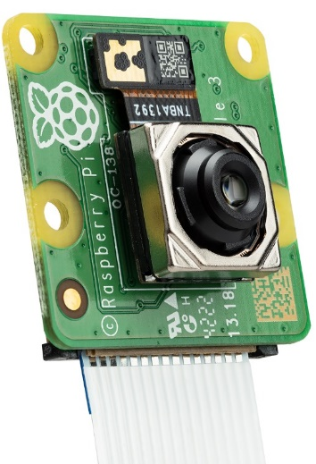
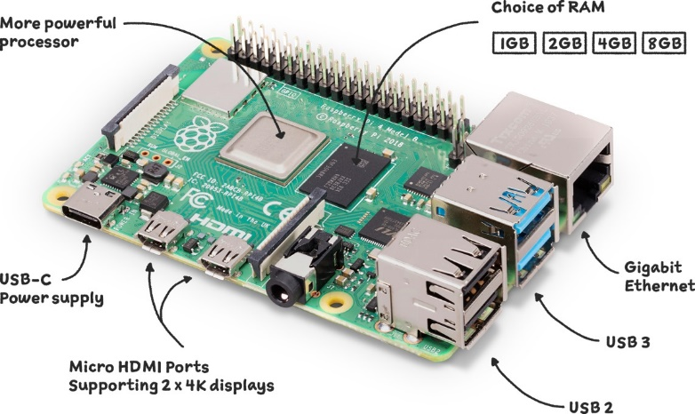
Components
Raspberry Pi 4 Model B is a single-board computer.
Comes with 1GB, 2GB, 4GB, or 8GB RAM options.
Features Quad-core Cortex-A72, 1.5GHz CPU.
Supports dual 4K HDMI, USB 3.0, and Gigabit Ethernet.
Raspberry Pi Camera Module for image and video capture.
Connects via CSI (Camera Serial Interface).
Supports 5MP, 8MP, or 12MP sensors.
Used for computer vision, surveillance, and AI projects.

Slide 4
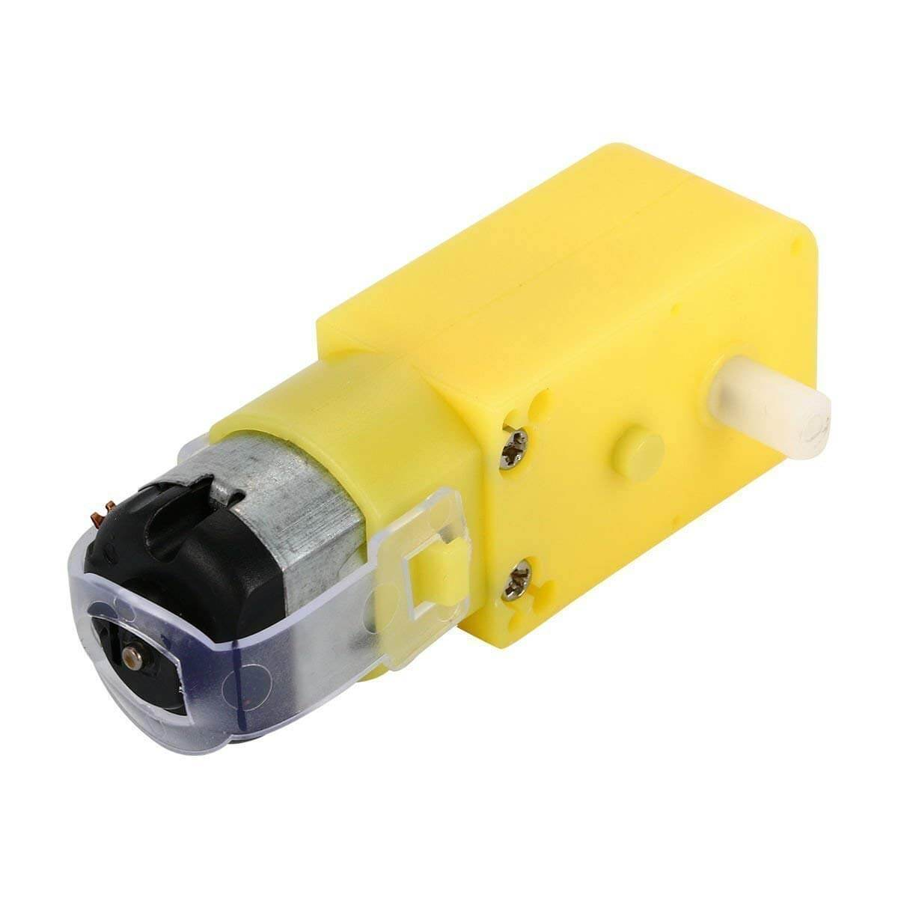
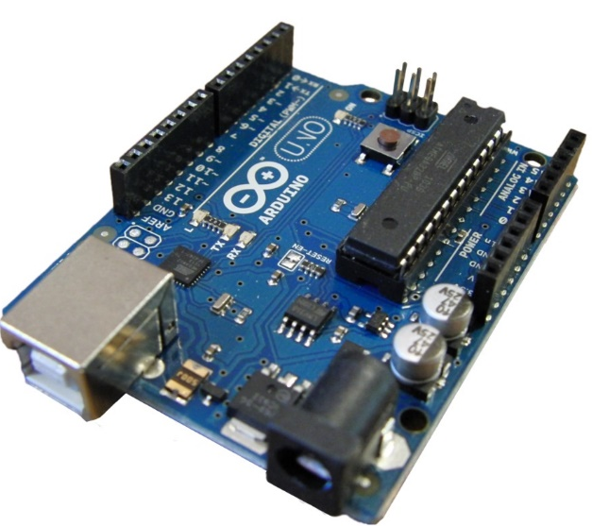
Components
Compact and lightweight microcontroller board.
Based on ATmega328P, operates at 5V, 16MHz.
Mini USB for programming and power.
14 digital I/O (6 PWM) and 8 analog inputs.
Gear motor combines a DC motor with a gearbox.
Provides high torque at low speeds.
Used in robots, conveyors, and automation.
Available in various RPM and voltage ratings.

Slide 5
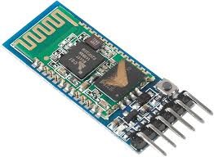
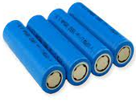
Components
Lithium-ion (Li-ion) batteries are rechargeable.
High energy density, lightweight, and long lifespan.
Commonly used in electronics, EVs, and robotics.
Requires BMS (Battery Management System) for safety.
HC-05 Bluetooth module for wireless communication.
Supports Master/Slave mode, uses UART (Rx/Tx).
Works on Bluetooth 2.0 + EDR, ~10m range.
5V power, 3.3V logic for Rx, default baud 9600.

Slide 6
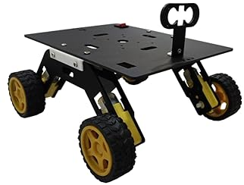
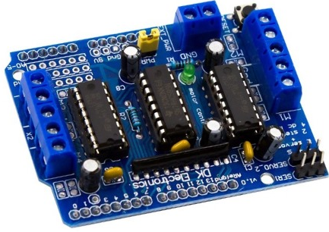
Components
Arduino Motor Driver Shield controls DC motors, servos, and steppers.
Based on L293D or L298P for motor control.
Supports 2-4 motors, with PWM speed control.
Powered by external supply (up to 12V) or Arduino.
Sturdy Build: Black Acrylic chassis with precision-cut holes.
High Mobility: Four large wheels for all terrains.
Modular Design: Attach sensors and controllers easily.
Versatile Use: Ideal for robotics and autonomous projects.
Custom Mounting: Drill holes as needed.
Extras: 3D-printed parts, two ultrasound holders, surprise item.

Slide 7
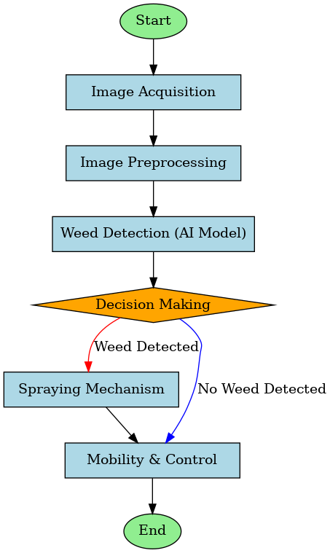

Flow Chart

Slide 8
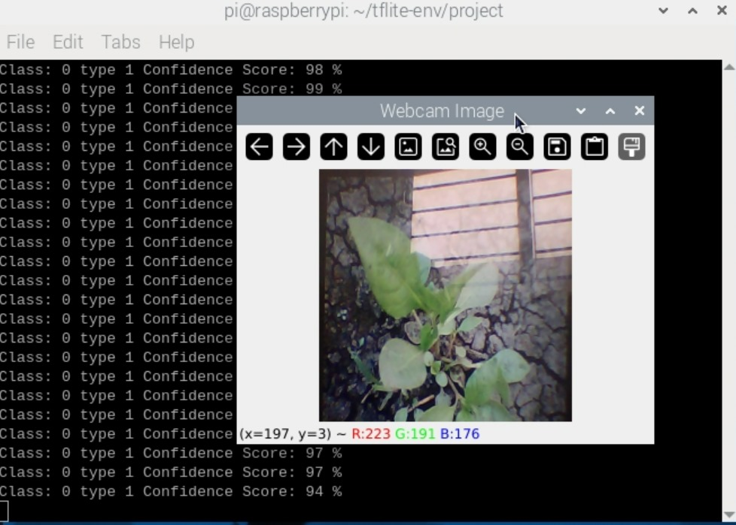
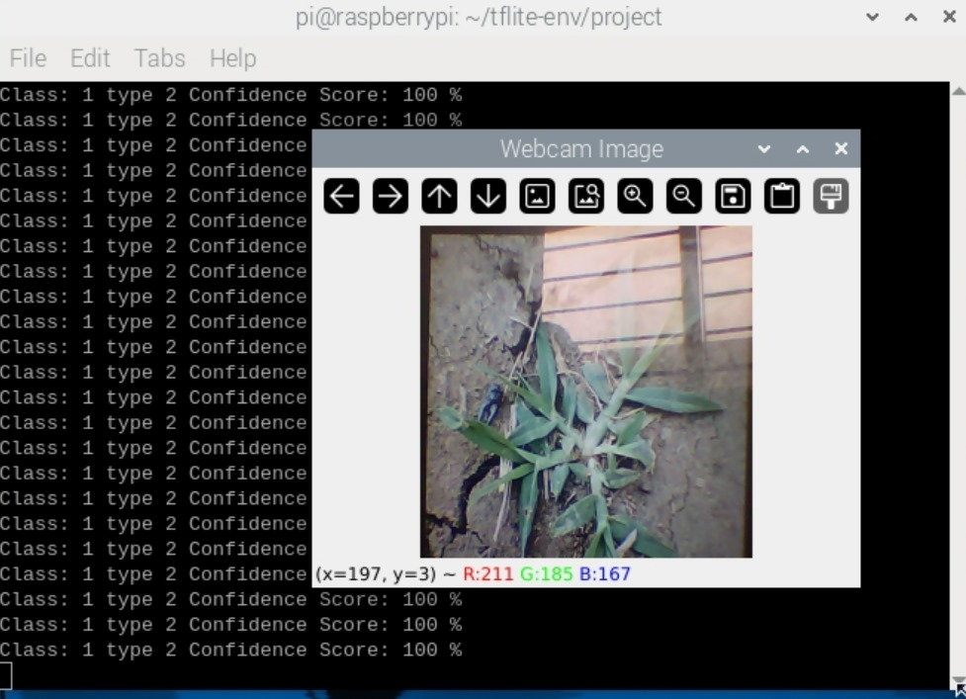
OUTCOMES
Amaranthus viridis t-1
Goosegrass t-2

Slide 9
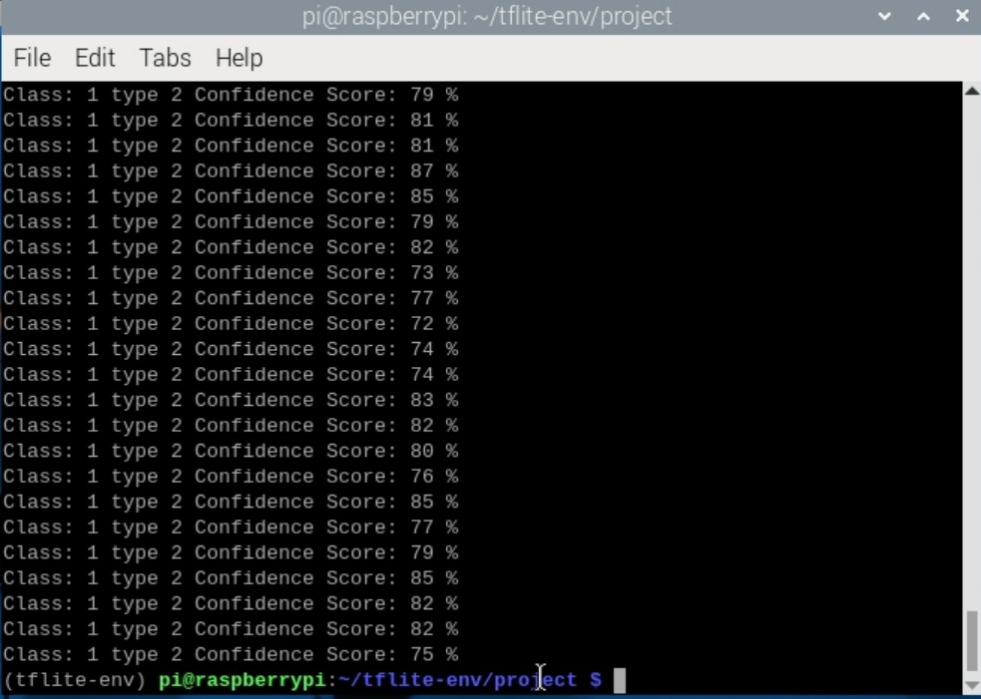
OUTCOMES

Slide 10
Module Description
🚜
The AI-driven weed detection and herbicide spraying system captures real-time images using a Pi Camera and processes them with OpenCV. A TensorFlow Lite model classifies weeds and crops, enabling precise herbicide spraying through a Raspberry Pi-controlled motor and pump system. An Arduino-powered mobility module ensures smooth navigation, while an HC-05 Bluetooth module allows remote monitoring. A 2.3W power bank and lithium-ion batteries efficiently power the system. This approach enhances precision agriculture by reducing herbicide waste and improving automation.

Slide 11
Conclusion
🌱
The AI-driven weed detection and herbicide spraying system enhances precision agriculture by automating weed identification and targeted herbicide application. By integrating Raspberry Pi, Arduino, TensorFlow Lite, and OpenCV, the system efficiently detects weeds, reduces herbicide waste, and minimizes manual labor. Remote monitoring via Bluetooth ensures ease of control, while optimized power management supports uninterrupted operation. This smart agricultural solution promotes cost-effectiveness, sustainability, and efficiency, making it a valuable tool for modern farming.

